Slide 1
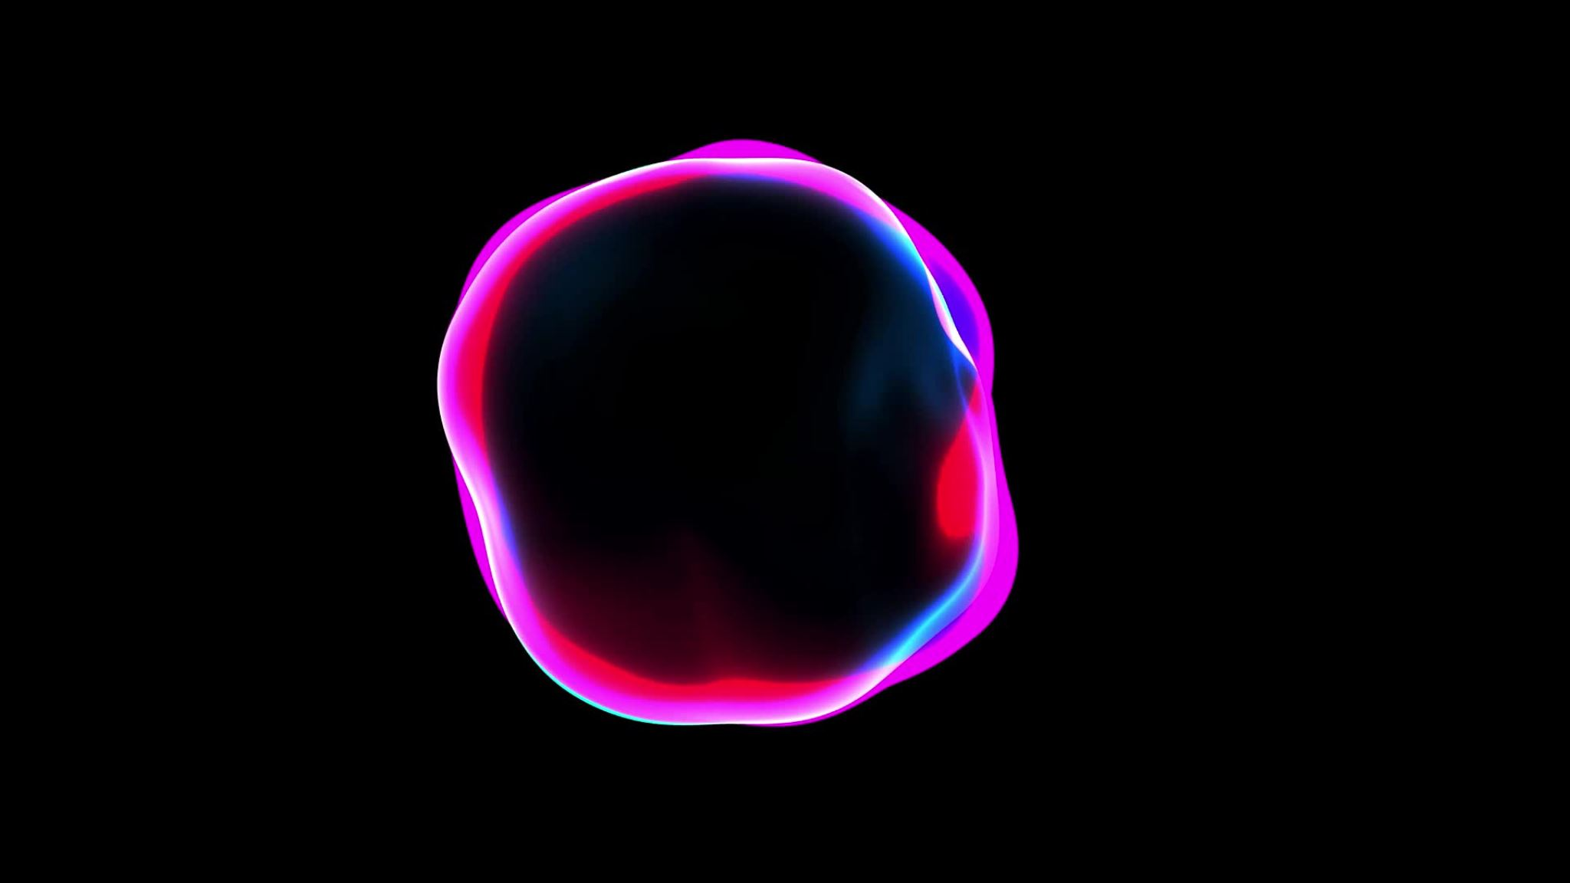
Stable Diffusion
Class 10/31

Slide 2
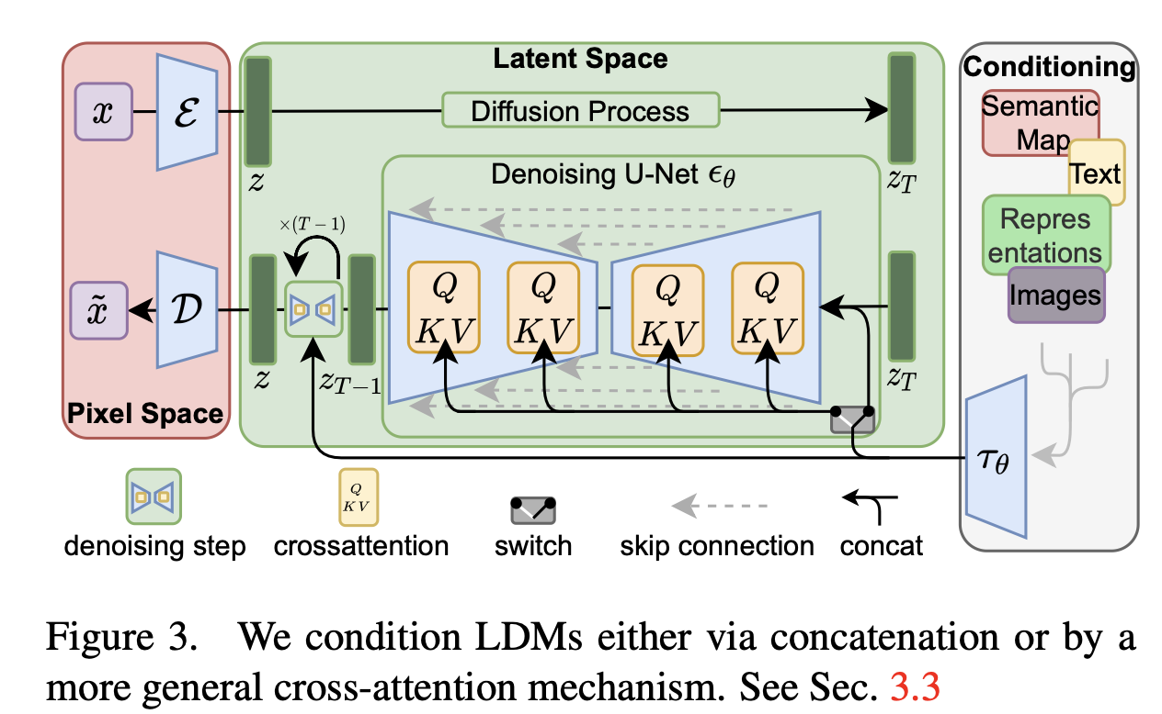
Overall Architecture
GAN tends to mode collapse
Diffusion is better this way

Slide 3
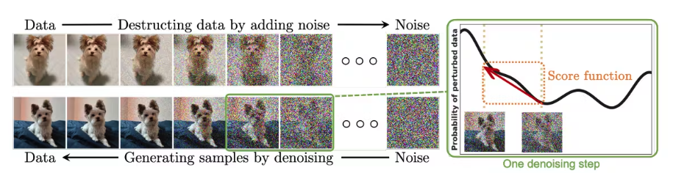
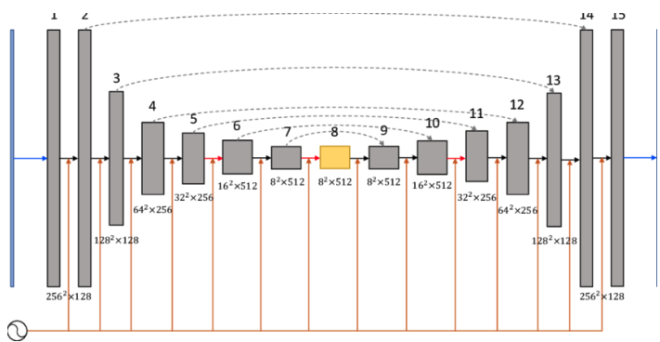
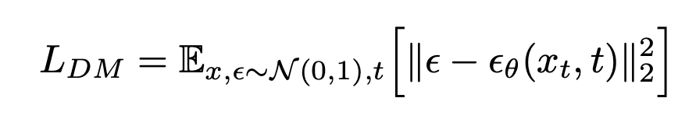
Diffusion Overview

Slide 4
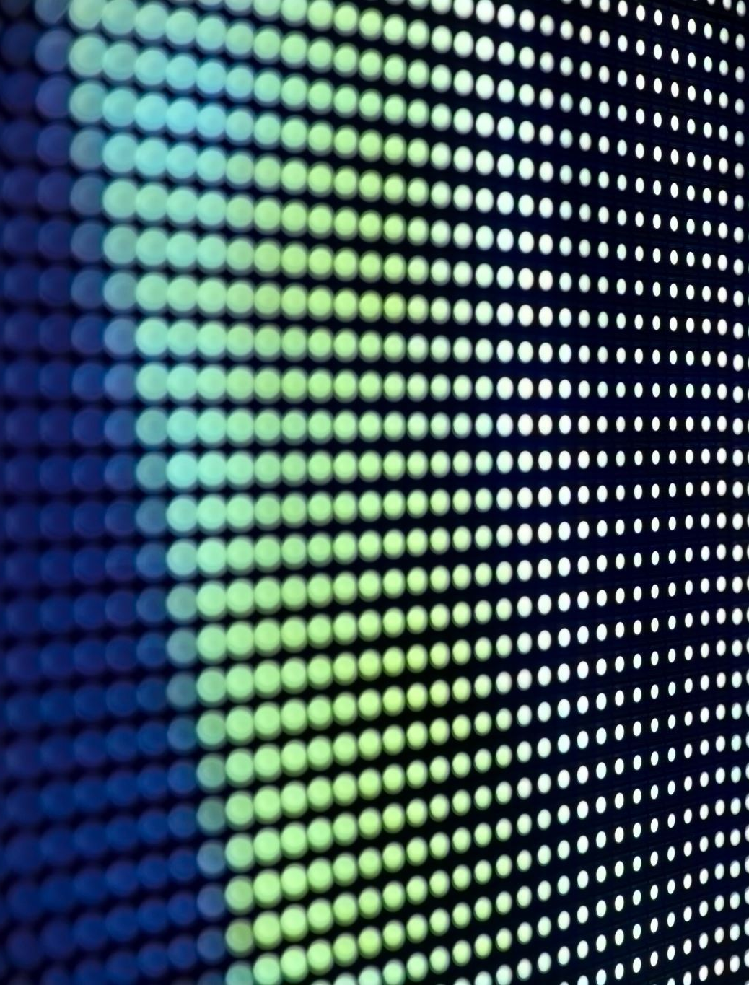
What's the issue with DM?
Works in the pixel space (x_t), so if you want to a high-res (e.g., 1024^2), that is a lot of resources needed
Very slow
Work like GLIDE overcomes this: Take a smaller image, do the diffusion, then upsample with a separate network

Slide 5
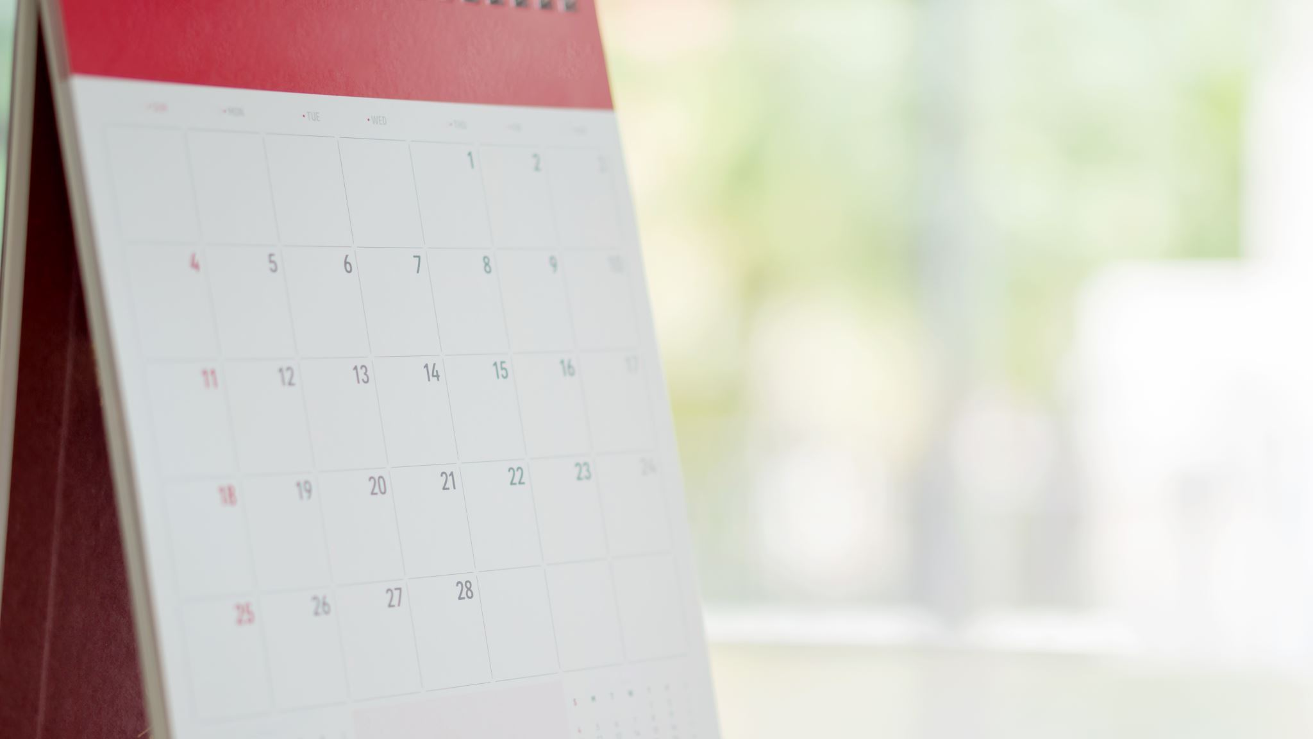
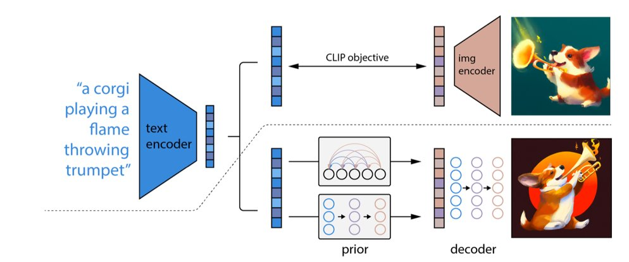
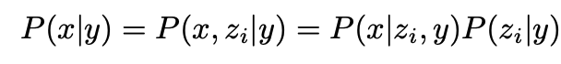
Recap
Instead of dealing with pixels, operates in the latent space

Slide 6
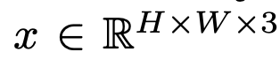
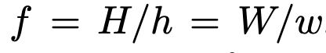
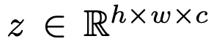
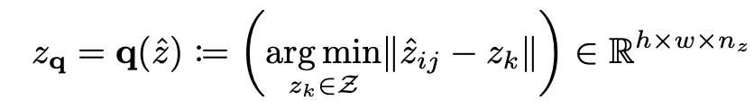
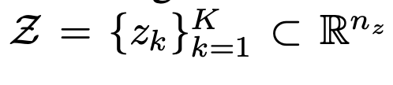
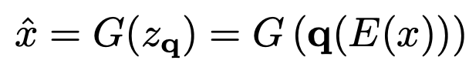
VQGAN
VQGAN
VQGAN:

Slide 7
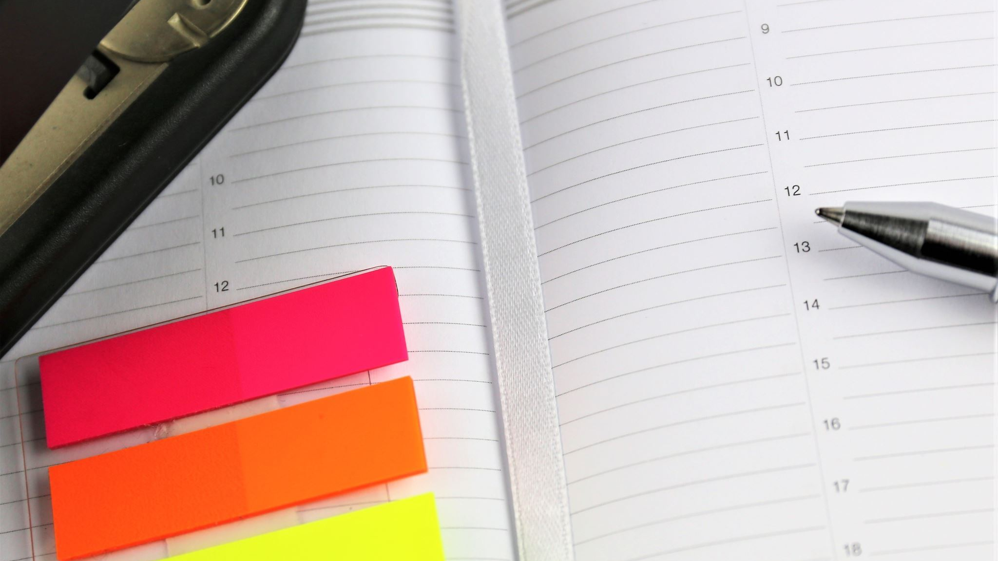
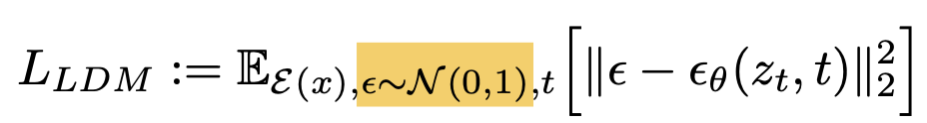
Important Note
Just need to train the compression model once (VQGAN, step 1), reuse for other diffusion model (step 2)
Due to the dimension reduction, LDM (Latent Diffusion Model, aka, Stable Diffusion) is much more efficient
LDM and DM are almost exactly the same except LDM takes in the latent as input

Slide 8
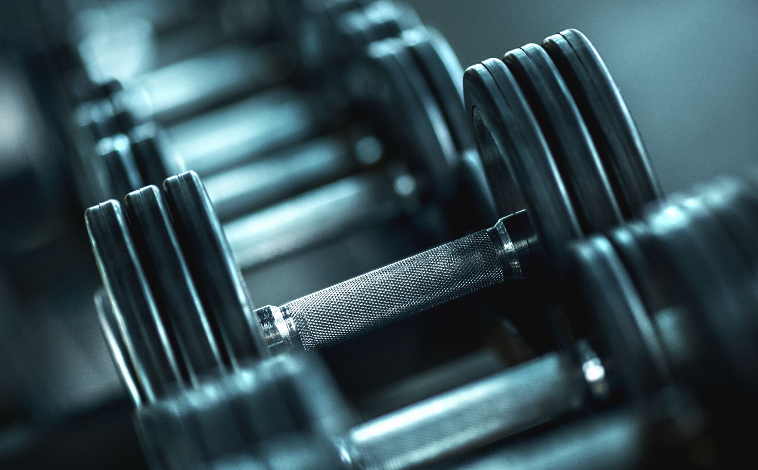
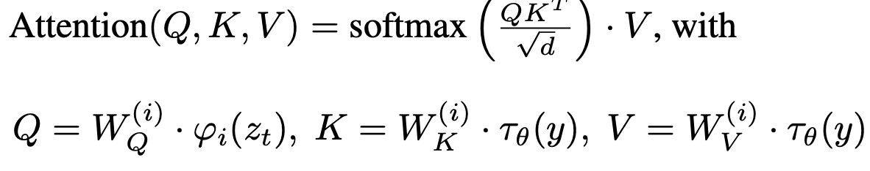
Conditioning
UNET
Encoder for condition

Slide 9
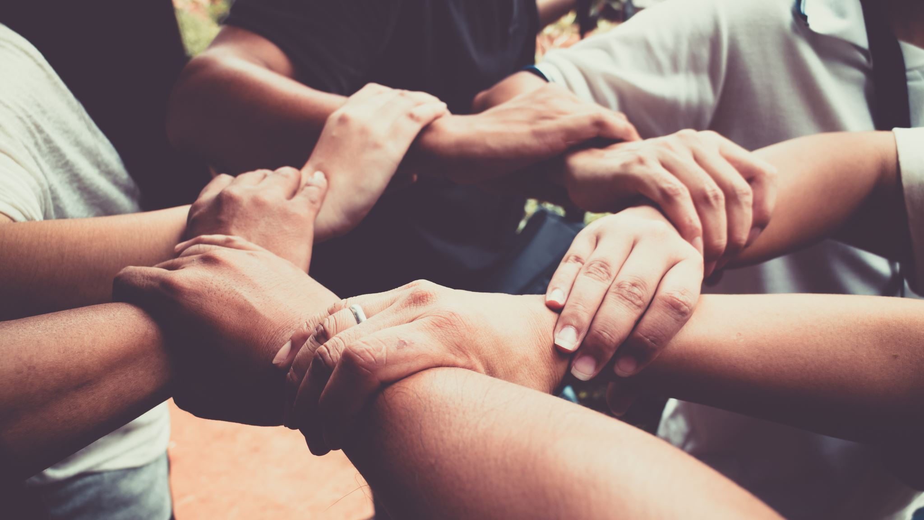
Bring It Together

Slide 10
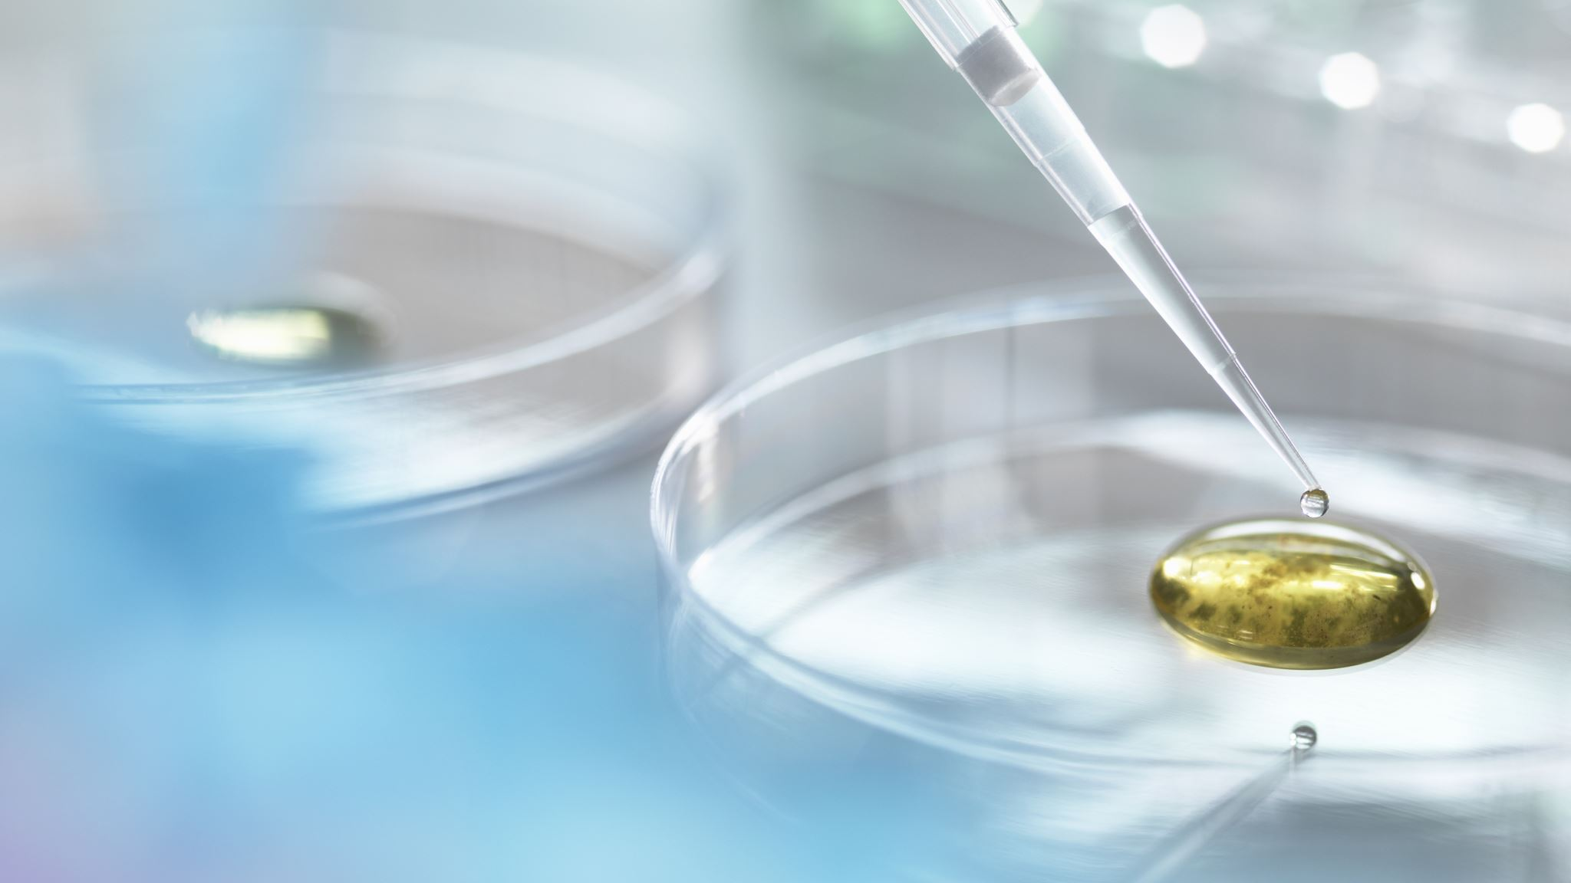
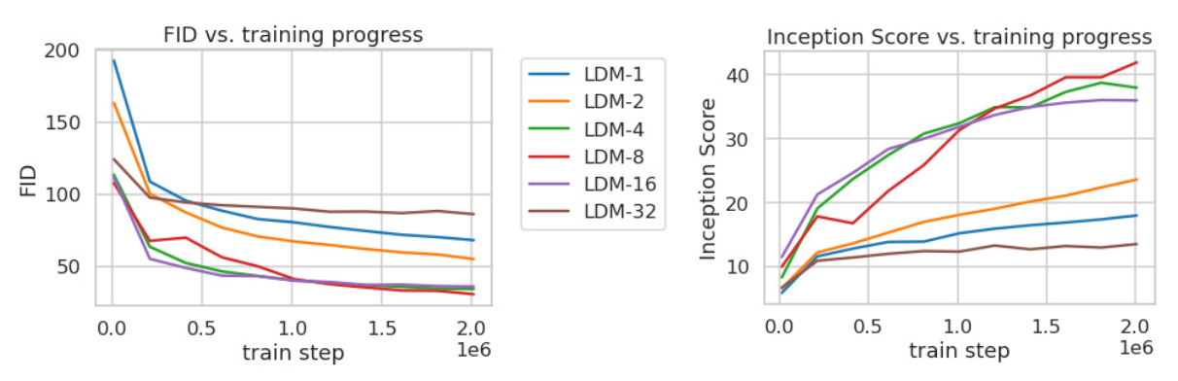
Experimental Findings
LDM trained in VQ space achieves better quality
LDM-{4-16} is a good balance between efficiency and perceptual faithfulness

Slide 11
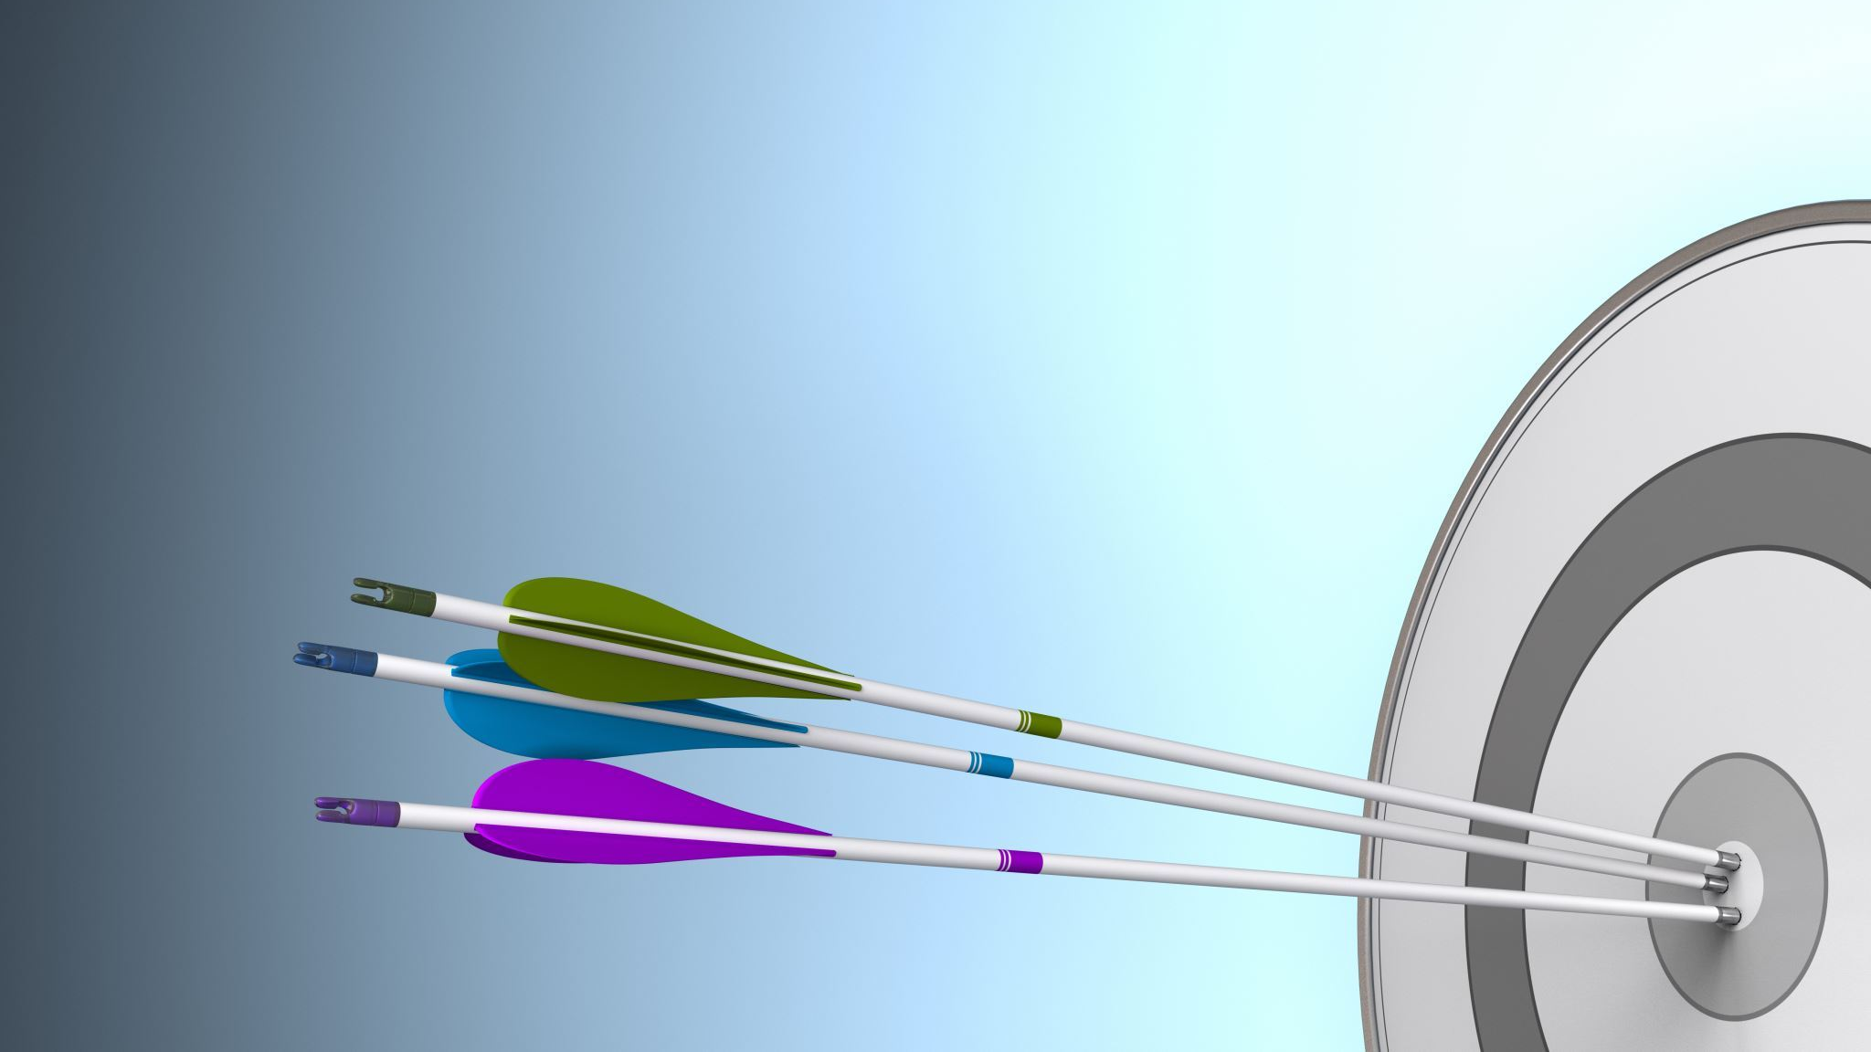
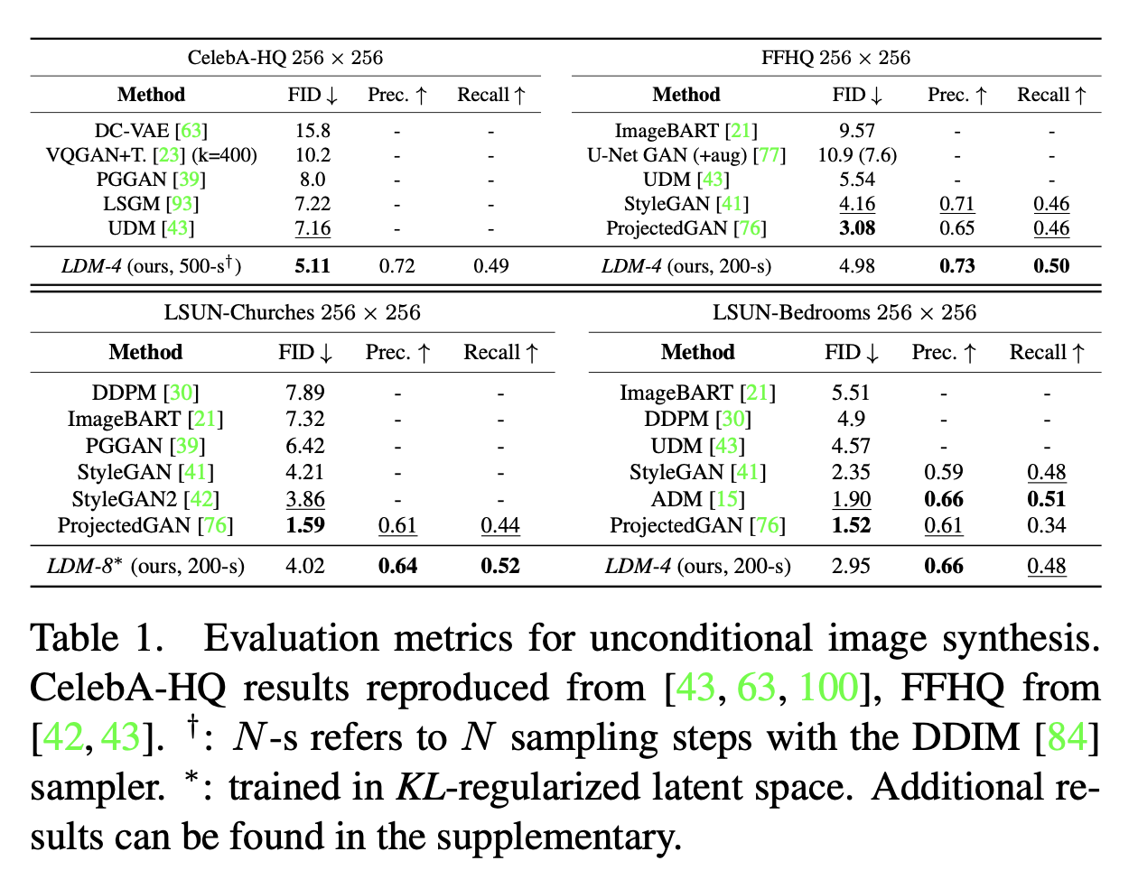
Experimental Results

Slide 12
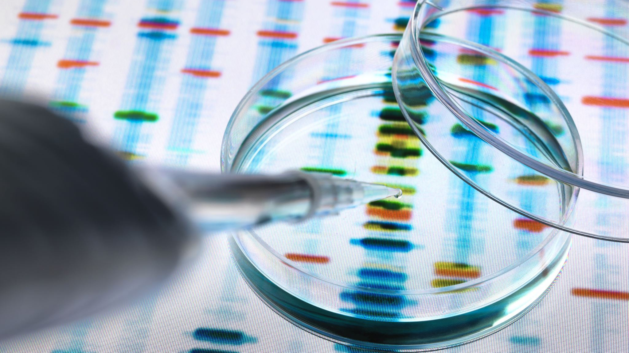
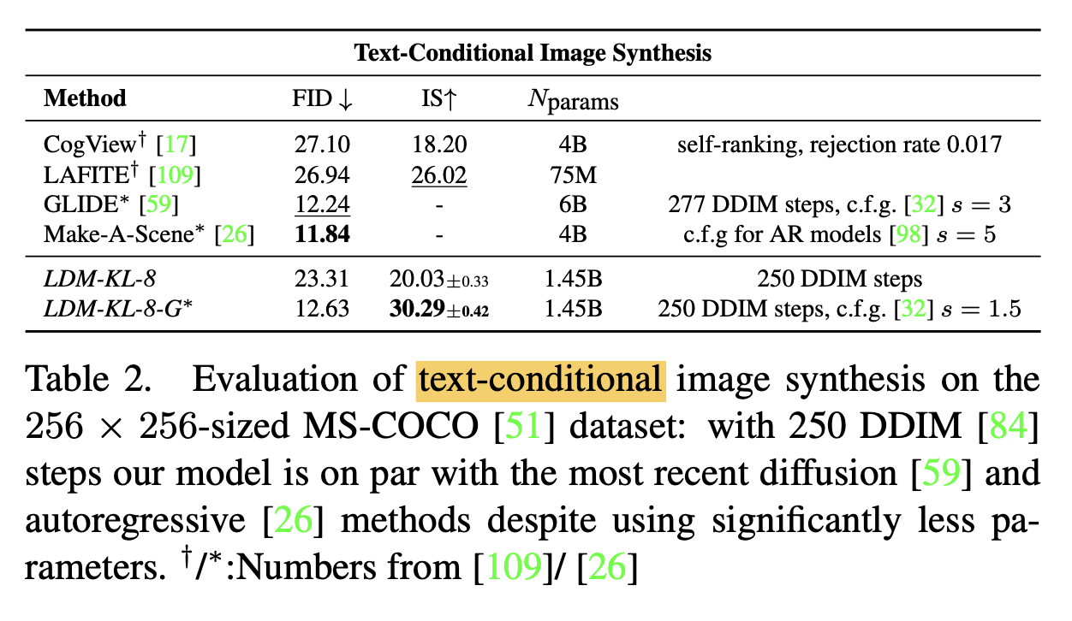
Experimental Results (Assignment)

Slide 13
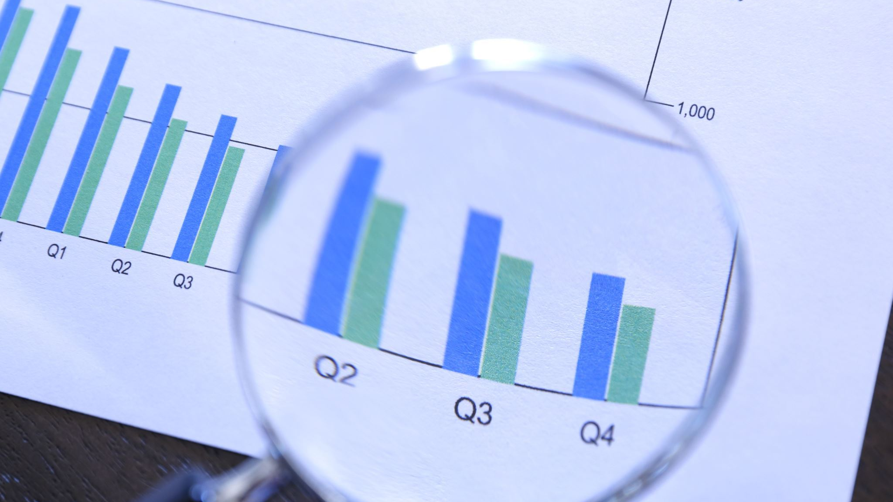
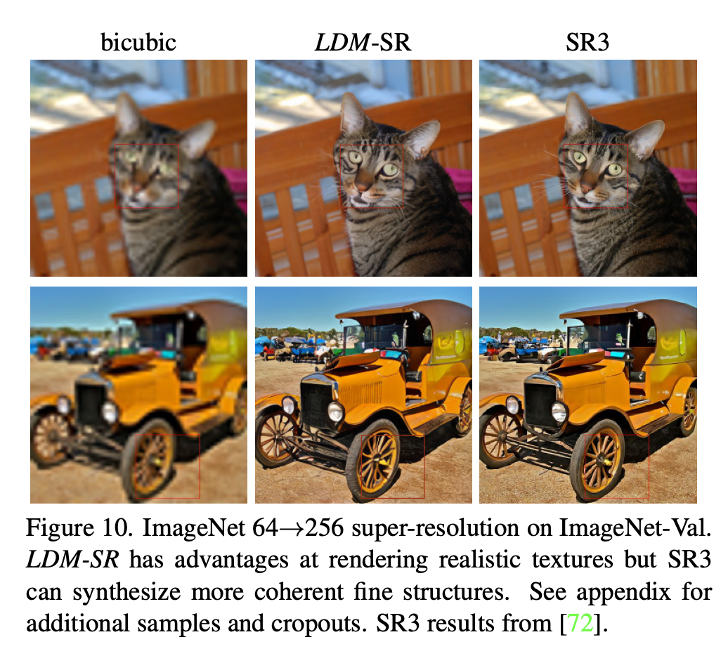
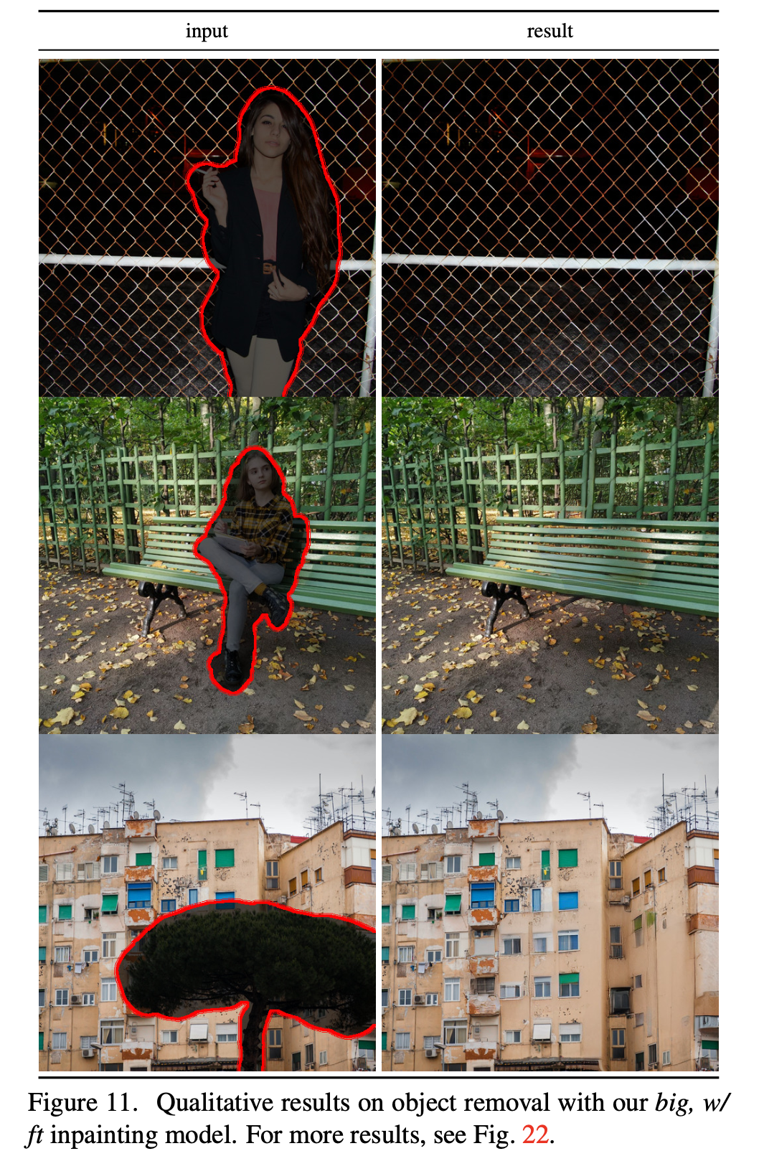
Qualitative Results (Assignment)

